Slide 1


Sysmon Config Pusher
ISSESSIONS – June 24th 2021
Anton Ovrutsky

Slide 2
What is Sysmon ?
“System Monitor (Sysmon) is a Windows system service and device driver that, once installed on a system, remains resident across system reboots to monitor and log system activity to the Windows event log”
AKA = Additional Visibility

Slide 3
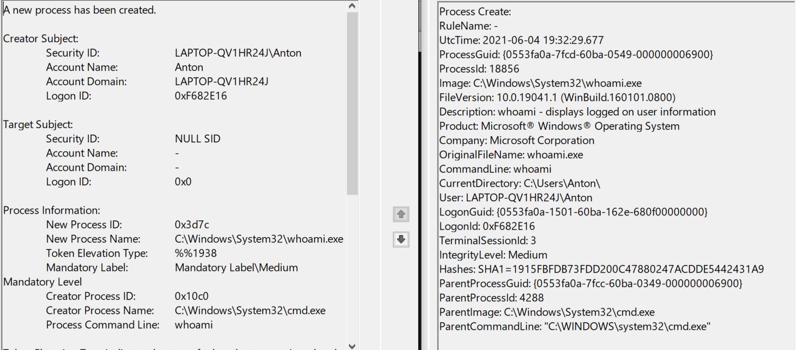
Why Do I Need This?

Slide 4
Why Do I Need This?
Just for ProcessCreate Events:
UTC Timestamp
ProcessGuid (piv-OT!)
Metadata (File Version, Description, Product, Company, Original File Name
Current Directory
Logon GUID
HASHES!

Slide 5
Why Do I Need This?
Which process contacted which IP Address
Which process made certain DNS query
Driver Loads
DLL/Image Loads
CreateRemoteThread / Process Injections
File / Registry / WMI Persistence / Clipboard

Slide 6



Challenge
Enable the right auditing on a Windows host to monitor file creation events
I’ll wait…

Slide 7
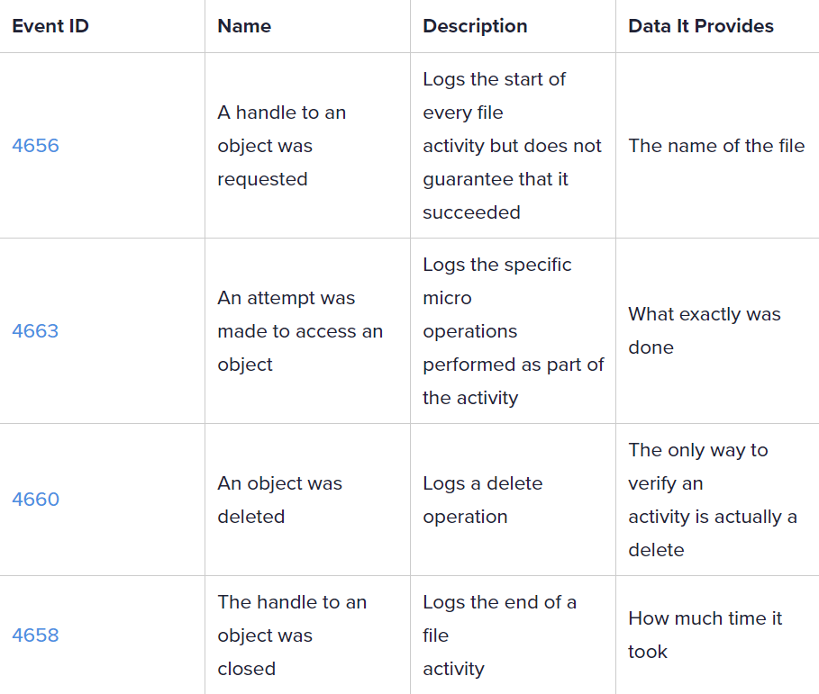

Object auditing in Windows is an awesome way to make SOC analysts hate you ☺
Notes:
https://www.varonis.com/blog/windows-file-system-auditing/

Slide 8
Challenge 2
Create a Log When PowerShell.exe Makes a Network Connection
I’ll wait…

Slide 9


¯\_(ツ)_/¯

Slide 10
Okay, but I have an EDR
EDR’s often do not expose their telemetry to the end user
If they do, the data are often limited and not in a standard format
Data are not stored in the Windows Event Log
Need to mess with APIs, often at additional cost to get raw EDR telemetry to a SIEM
If the EDR does not log something you need?

Slide 11

Okay, give me Sysmon Please
How do I deploy it ?
Group Policy / SCCM / Custom Scripts / Splunk App
What events do I log with it?
Two popular configurations exist to get you started here

Slide 12
Deploying Sysmon
Most popular methods, script that gets pushed via GPO:
https://www.syspanda.com/index.php/2017/02/28/deploying-sysmon-through-gpo/
https://github.com/DustyMMiller/Sysmon/blob/master/sysmon.ps1
Script looks for a newer Sysmon configuration file in a specified directory, scheduled task runs script every X minutes/hours, if there is a newer version of the Sysmon config, update it

Slide 13
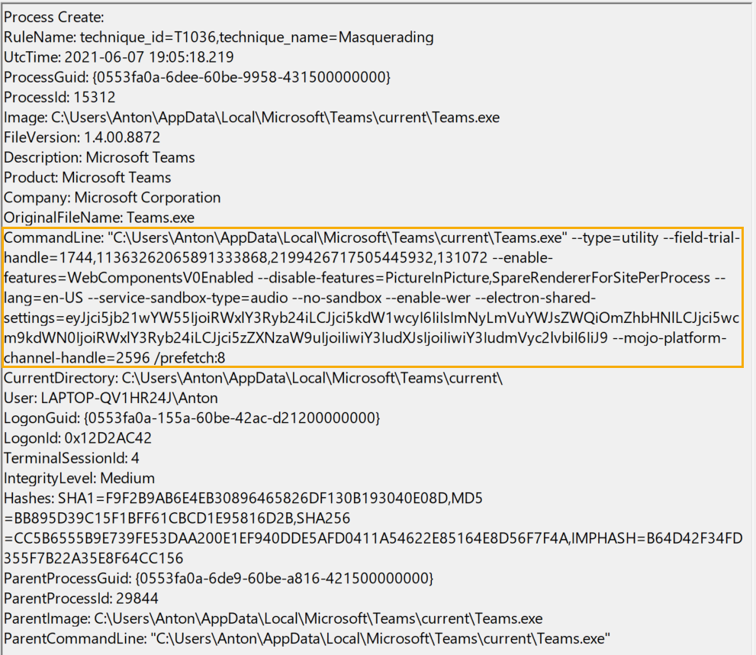
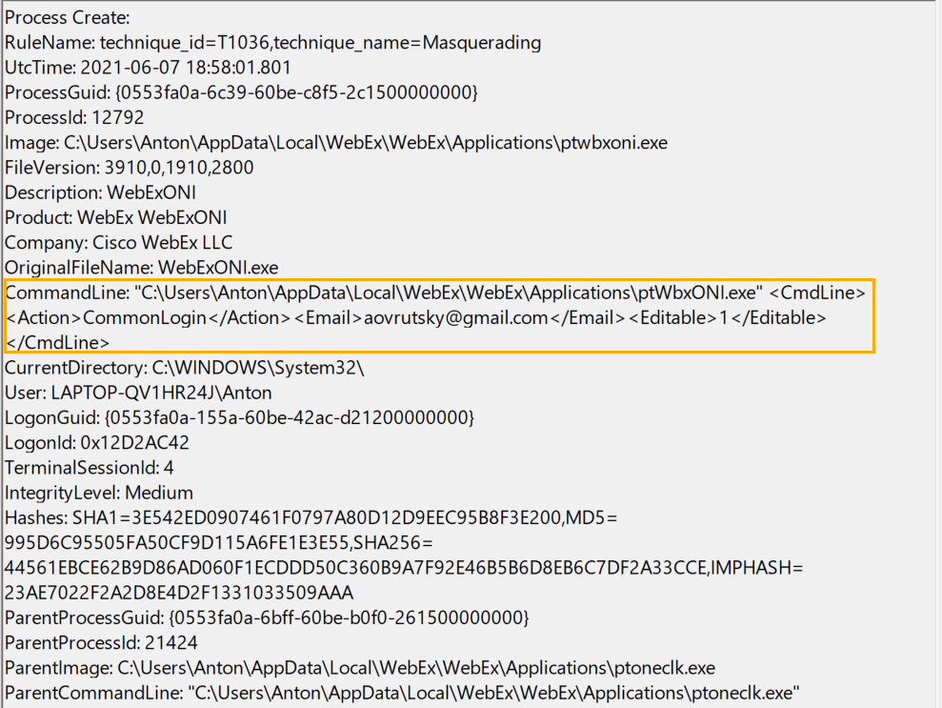
The Noise Is Real

Slide 14
The Logic
One of the biggest benefits to Sysmon is its configuration file, you can filter as you please, either removing or adding elements
It makes sense then, that you want as much flexibility around managing your configuration file as possible, in order to extract the maximum amount of value from your Sysmon deployment while minimizing the noise

Slide 15
Issues with the GPO Approach
Eventually, you will want different versions of your configuration file for different network segments
Think Workstations vs Servers
HR Department vs Developers
Visual Studio is NOISY
Security team may not have control over Group Policy
Changes to Group Policy may require tickets, change control, politics

Slide 16
Sysmon Config Pusher
Pushes configurations rather than having endpoints “poll and pull”
Pushed from any machine with .NET
No modifications to GPOs / Scripts or Scheduled Tasks needed
Configuration files are managed with tags
“HR” tag
“Dev” tag
“Minimal” tag
Uses WMI under the hood

Slide 17
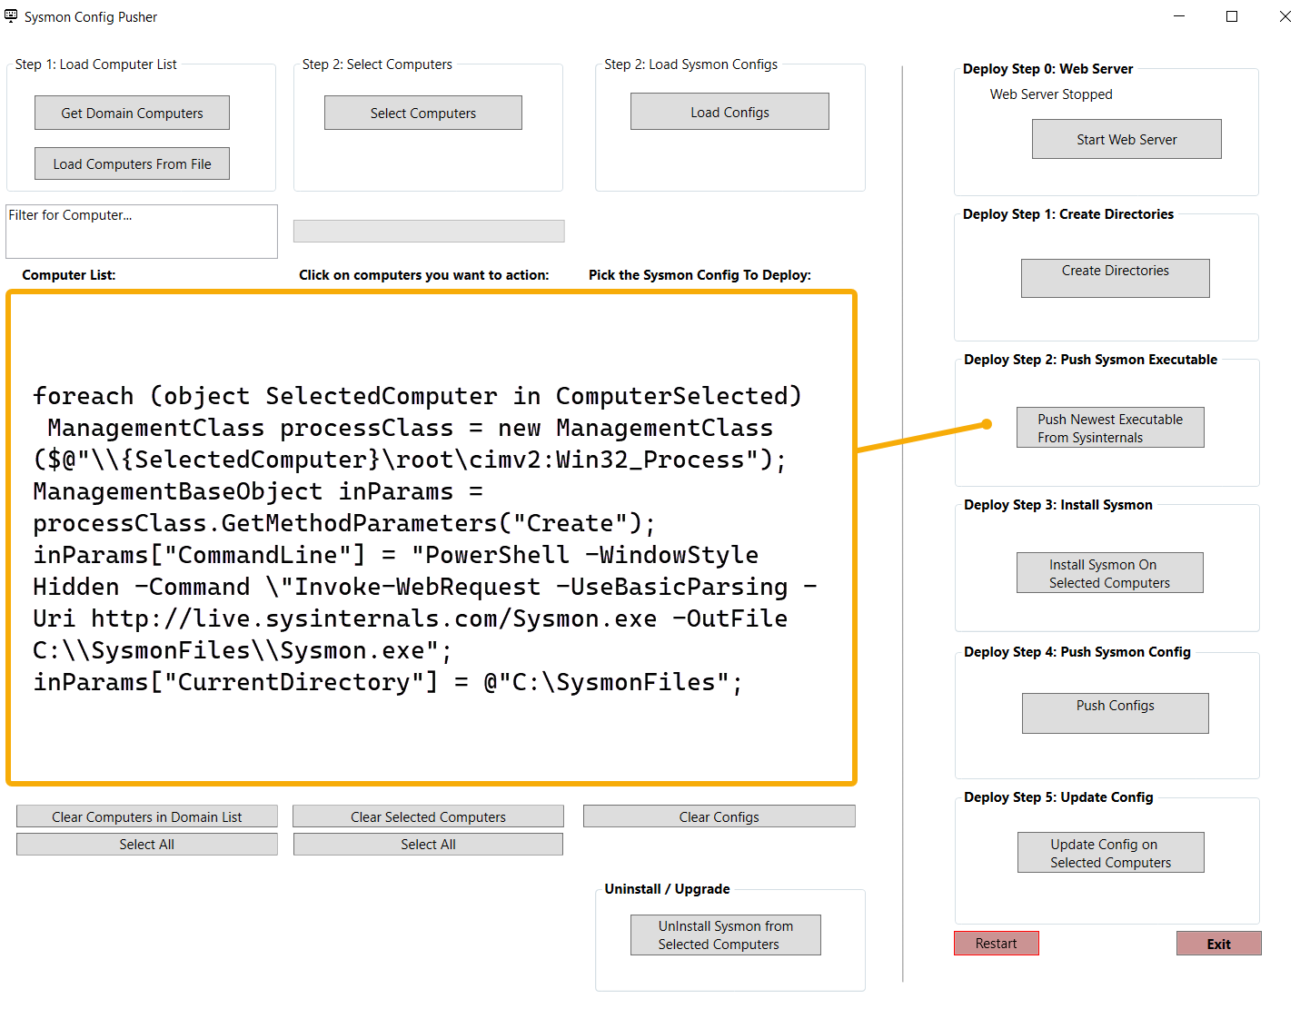
How It Works
Various commands mapped to different buttons in the Sysmon Config Pusher GUI:

Slide 18
How It Works
WMI utilized to start a process on a remote machine
On remote machines, PowerShell utilized for most functionality
Boils down to the following commands…

Slide 19
Download Config From SCP Endpoint:
PowerShell -WindowStyle Hidden -Command \"Invoke-WebRequest -UseBasicParsing -Uri http://"+ configWebServerIP +"/" + FinalSysmonMatchedConfig + " -OutFile C:\\SysmonFiles\\" + FinalSysmonMatchedConfig
Create Working Directory On Remote Host:
PowerShell -WindowStyle Hidden -Command New-Item -Path C:\\ -Name SysmonFiles -ItemType Directory
Update the Sysmon Config:
inParams["CommandLine"] = "C:\\SysmonFiles\\Sysmon.exe -c " + FinalSysmonMatchedConfig;
Download New Version of Sysmon:
PowerShell -WindowStyle Hidden -Command \"Invoke-WebRequest -UseBasicParsing -Uri http://live.sysinternals.com/Sysmon.exe -OutFile C:\\SysmonFiles\\Sysmon.exe
Uninstall Sysmon:
inParams["CommandLine"] = "C:\\SysmonFiles\\Sysmon.exe -u";
Install Sysmon:
inParams["CommandLine"] = "C:\\SysmonFiles\\Sysmon.exe -accepteula -i";

Slide 20
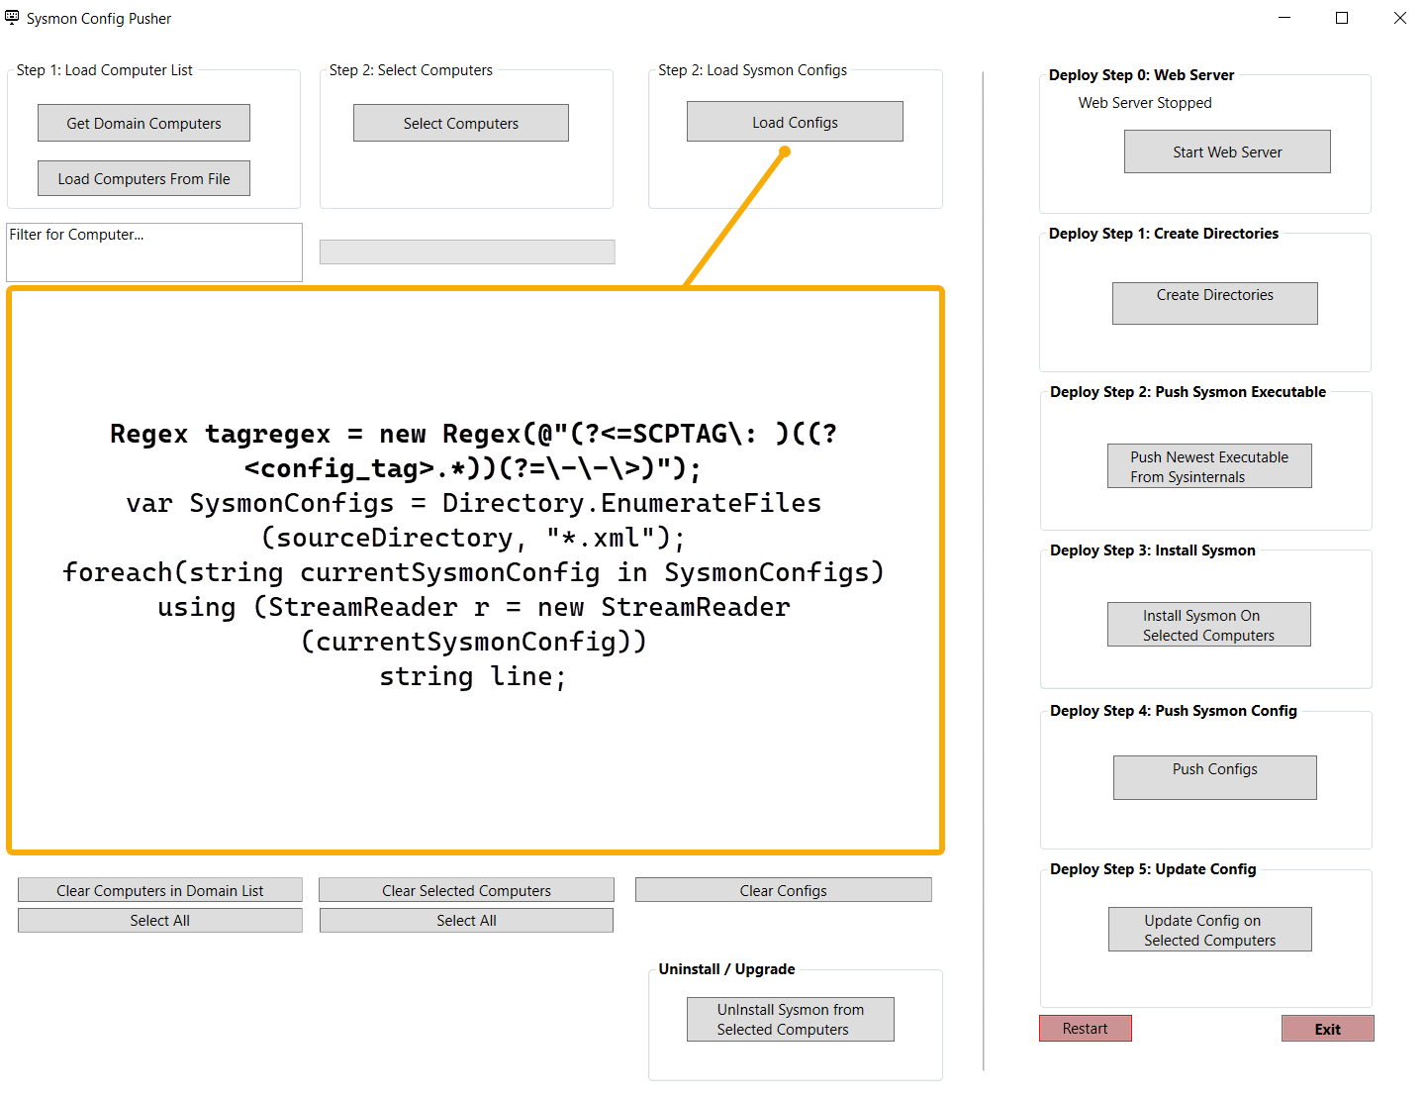
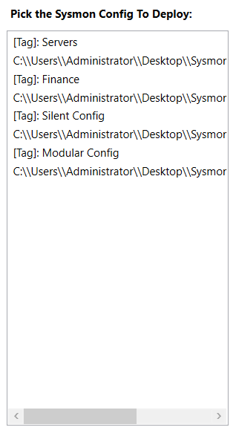
Tag Extraction

Slide 21
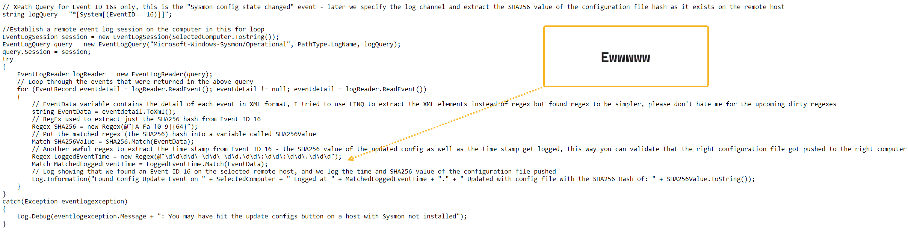
Config File Update Validation

Slide 22
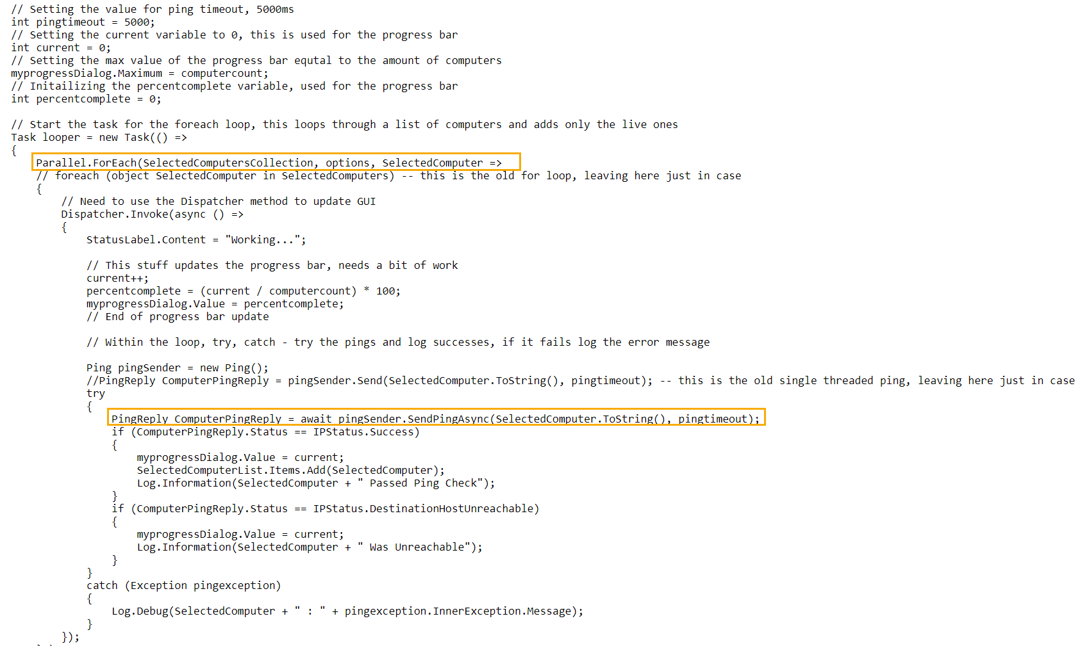
Parallelism

Slide 23
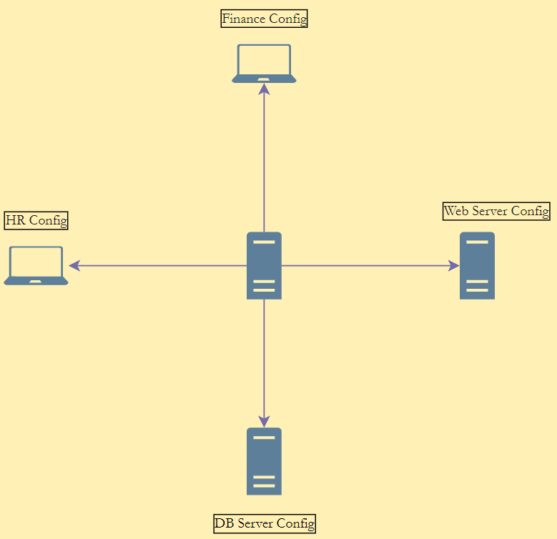
Putting It Together

Slide 24

Lessons Learned
Coding is more fun with utility
Error checking and exception handling is important
Logging is critical
Parallelism is tricky
Microsoft docs = hard mode

Slide 25

Contributing
Contributions to SysmonConfigPusher more than welcome and encouraged if that is your jam
Application needs more testing, more robust error handling, additional functionality etc

Slide 26
Contributing – Sysmon Ecosystem
Let’s step back for a second and think about what is required to get Sysmon deployed in an organization
Service Desk
Sysops / IT / Server Admins
End-Users
Change Control
Responsibility Assignment Matrix
Who manages config ?
Who is responsible for system disruption ?
Who maintains the deployment ?

Slide 27
Where I see gaps
Lack of Sysmon metrics
What is the expected number of events per host?
What is the impact in terms of CPU, Disk, RAM utilization per host?
What is the expected number of events per host, per event type?
What event types cause more noise / resource utilization on systems ?
Lack of config diversity
Only two major updated configuration files currently, a few years ago there was more
Lack of use-case articulation (I do see some movement here)
Defensive community struggles to articulate how Sysmon fits into the broader defensive ecosystem (Sysmon vs EDR vs MDE)
Fear of false positives

Slide 28

Thank you! … Questions ☺

